Slide 1
Produkt-, Quotienten- und Kettenregel Ableitungsregeln - Differentialrechnung

Slide 2
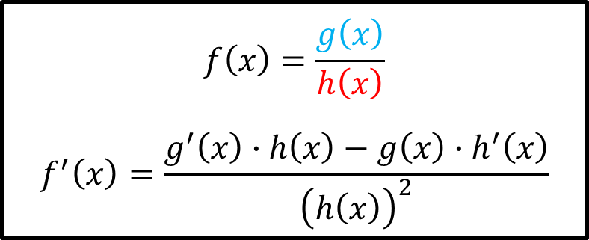
Bsp. 1) Bestimme die erste Ableitung $f^{′}\left(x\right).$
$$f\left(x\right)=g\left(x\right)∙h\left(x\right)$$
$$f^{′}\left(x\right)=g^{′}\left(x\right)∙h\left(x\right)+g\left(x\right)∙h^{′}\left(x\right)$$
$$f\left(x\right)=\frac{x∙{\left(3x+1\right)}^{2}}{2x−1}$$
$$f\left(x\right)=\frac{g\left(x\right)}{h\left(x\right)}$$
$$f^{′}\left(x\right)=\frac{g^{′}\left(x\right)∙h\left(x\right)−g\left(x\right)∙h^{′}\left(x\right)}{{\left(h\left(x\right)\right)}^{2}}$$
$$f\left(x\right)=g\left(h\left(x\right)\right)$$
$$f^{′}\left(x\right)=g^{′}\left(h\left(x\right)\right)∙h^{′}\left(x\right)$$

